Slide 1
APPLICATION SOFTWARE

Slide 2
Objectives:
Application Software
Business Software
Graphics & Multimedia Software
Software for Home, Personal, and Educational Use.
Software for Communications
Widely Used Utility Programs
Applications on the Web
Learning Aids and Support Tools w/in an Applications.

Slide 3
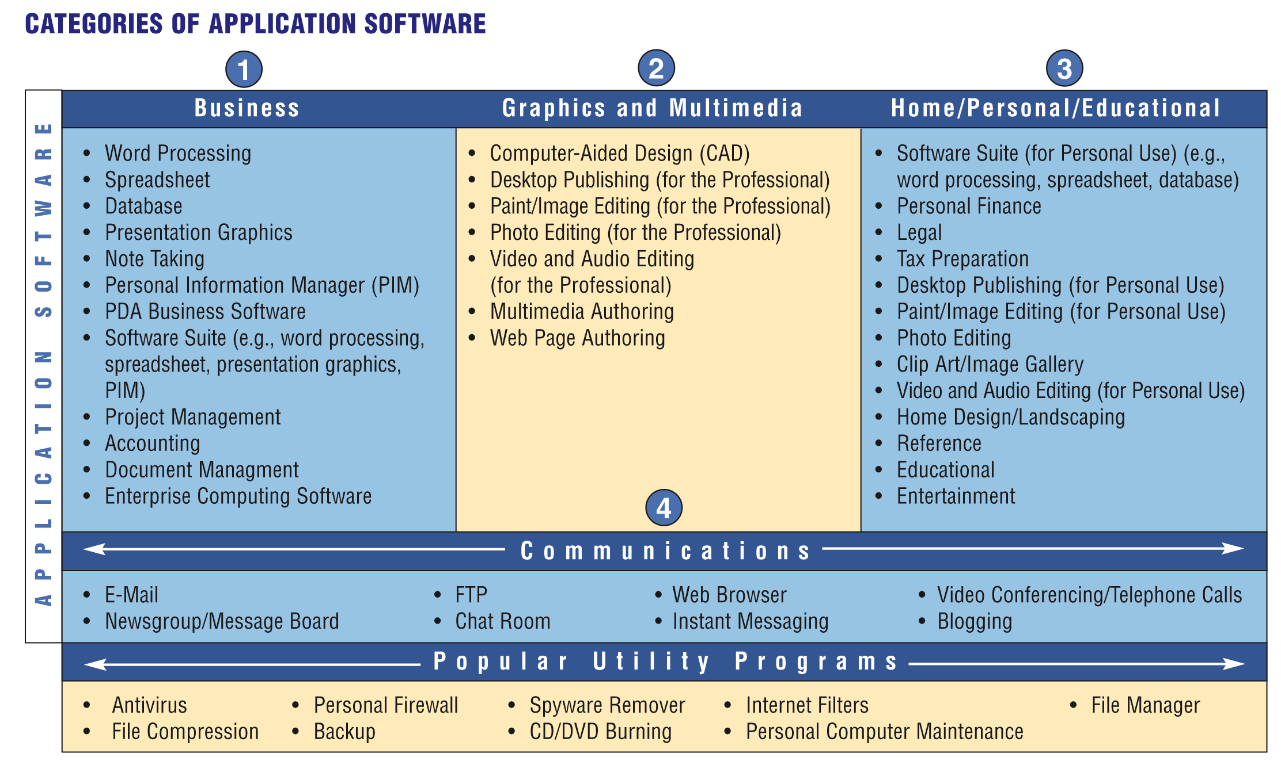
Application Software
What is application software?
Programs designed to make users more productive and/or assist them with personal tasks
p. 134 Fig. 3-1
Next

Slide 4
Application Software
How is software distributed?
  Packaged software, mass-produced
  Custom software, performs functions specific to a business or industry
  Open source software, provided for use, modification, and redistribution
  Shareware, copyrighted software that is distributed free for trial period
  Freeware, copyrighted software provided at no cost
  Public-domain software, freeware with no copyright restrictions
p. 135
Next

Slide 5
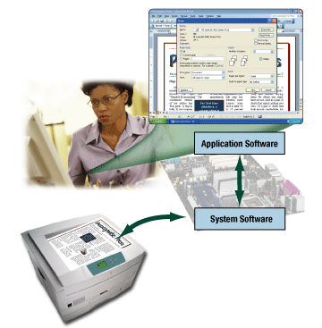
Application Software
What is system software?
  Programs that control the operations of the computer
  Serves as the interface between the user, the application software, and the computer’s hardware
p. 135 Fig. 3-2
Next

Slide 6
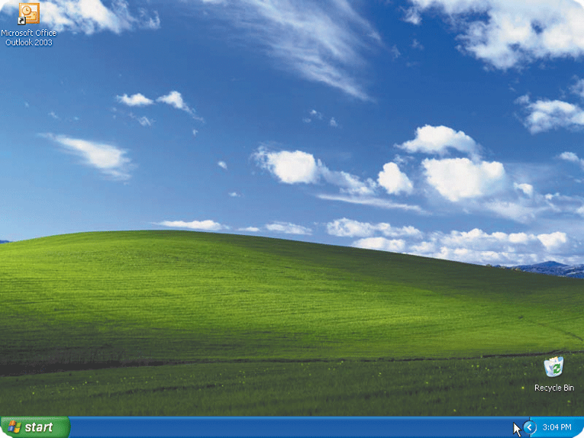
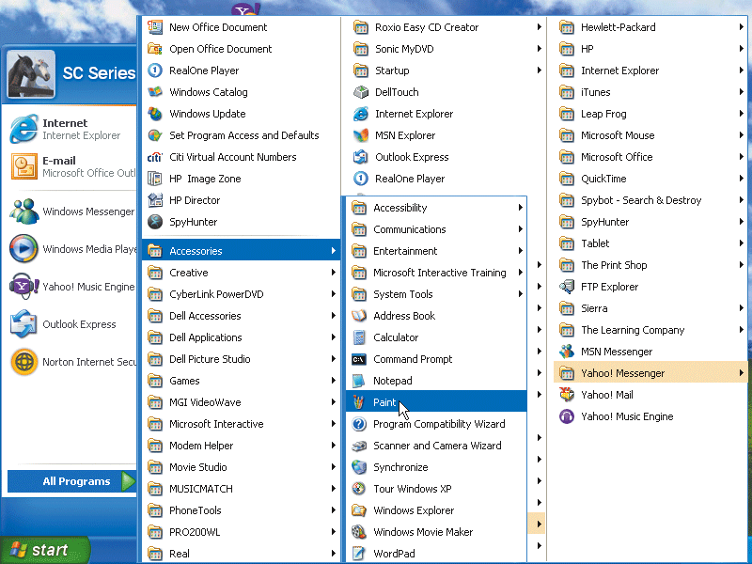
Application Software
How do you start an application?
  From the desktop, click the Start button, point to All Programs, and click the name of the application
  The program’s instructions load into memory
Application
Start button
All Programs
p. 136 Fig. 3-3
Next

Slide 7
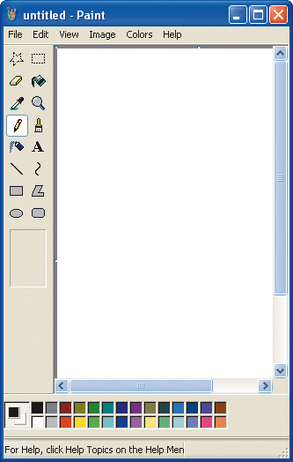
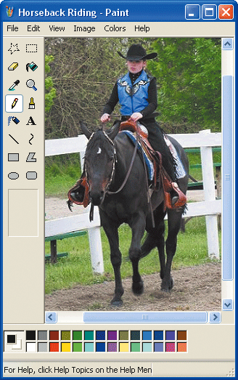
Application Software
What is a window?
  A rectangular area of the screen that displays a program, data, and/or information
Menu Bar
p. 136 - 137 Fig. 3-3
Next

Slide 8
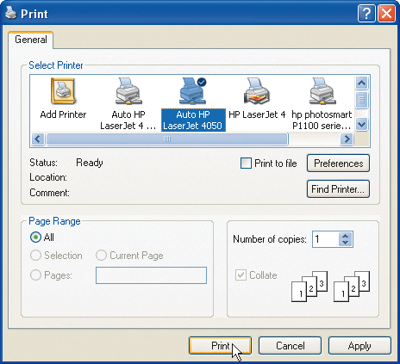
Application Software
What is a dialog box?
  A window that provides information, presents available options, or requests a response
p. 136 - 137 Fig. 3-3
Next

Slide 9
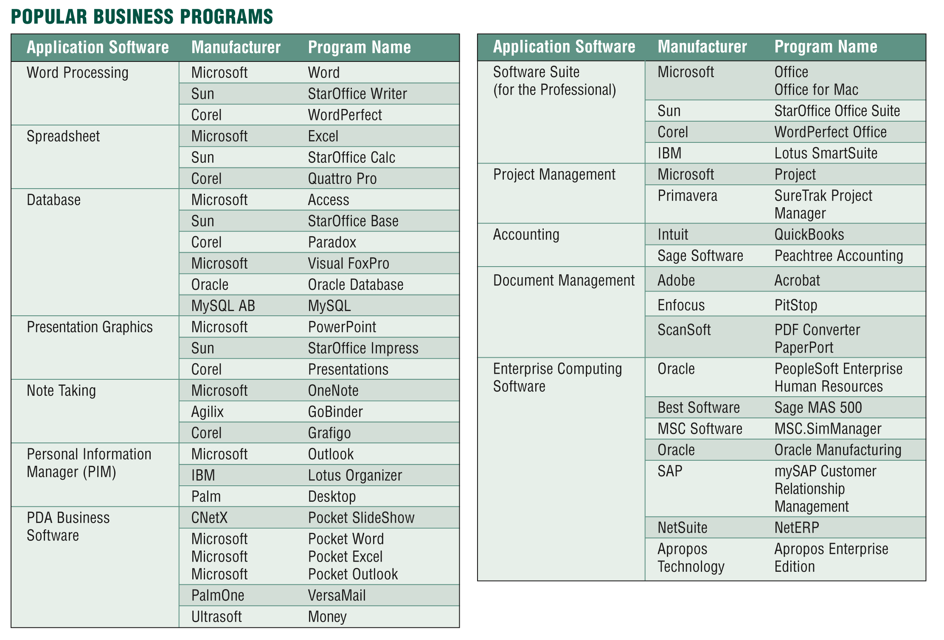
Business Software
What is business software?
  Application software that assists people in becoming more effective and efficient
p. 138 Fig. 3-4
Next

Slide 10
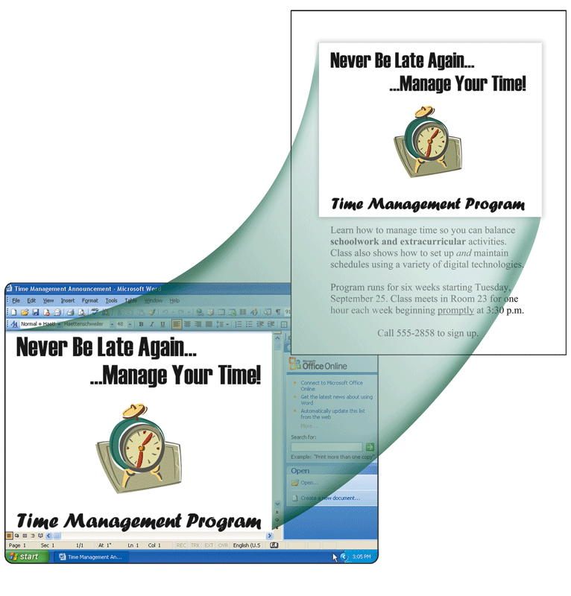
Business Software
What is word processing software?
  Allows users to create and
  manipulate text and graphics
    Clip art is a collection
    of graphics
    that you can
    insert in
    documents
p. 138 – 139 Fig. 3-5
Next

Slide 11
Business Software
What are popular word processing features?
AutoCorrect
AutoFormat
Collaboration
Columns
Grammar
Checker
Ink Input
Macros
Mail Merge
Reading
Layout
Research
Smart Tags
Tables
Templates
Thesaurus
Tracking
Changes
Voice
Recognition
Web Page
Development
p. 140 Fig. 3-6
Next

Slide 12
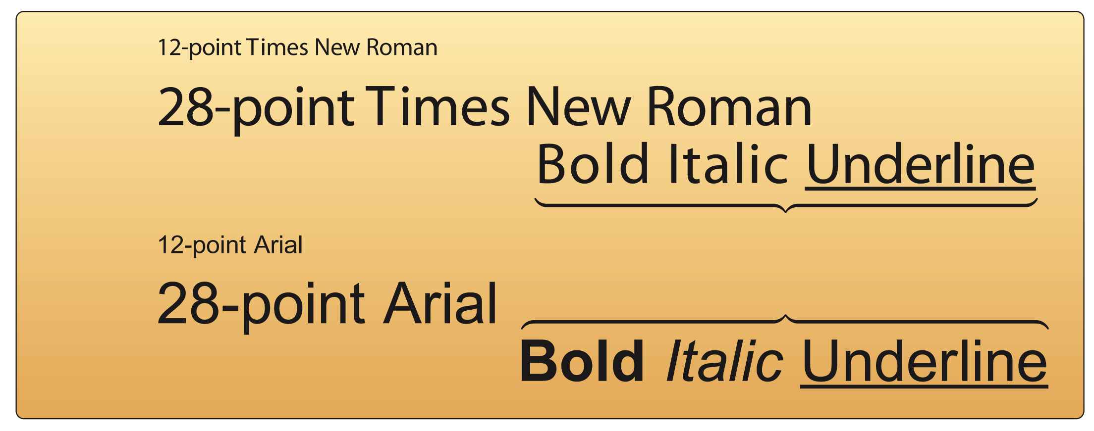
Business Software
What is a font?
  A name assigned to a specific design of characters
  Font size indicates the size of the characters in a particular font in points (a single point is about
  1/72 of an inch in height)
  Font style adds
  emphasis to a
  font such as
  bold, italic,
  and underline
p. 141 Fig. 3-7
Next

Slide 13
Business Software
What is spreadsheet software?
  Organizes data in rows and columns
  Performs calculations and
  recalculates when data changes
= A1+B2 (*C12)
= D1+E2 (*F12)
= SUM (C12:Y12)
p. 142
Next

Slide 14
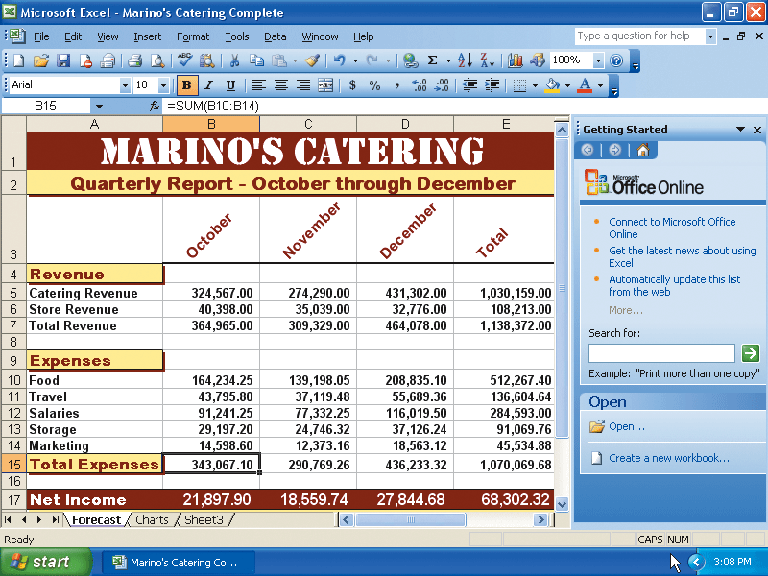
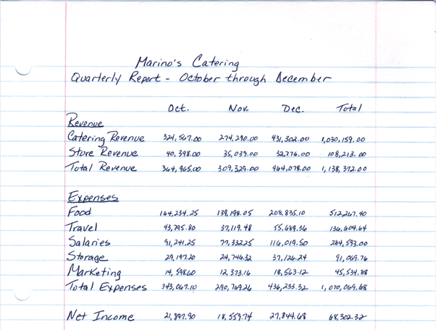
Business Software
How is a spreadsheet organized?
Columns identified by letters
Rows identified by numbers
A cell is the intersection of a column and row
p. 142 - 143 Fig. 3-8
Next

Slide 15
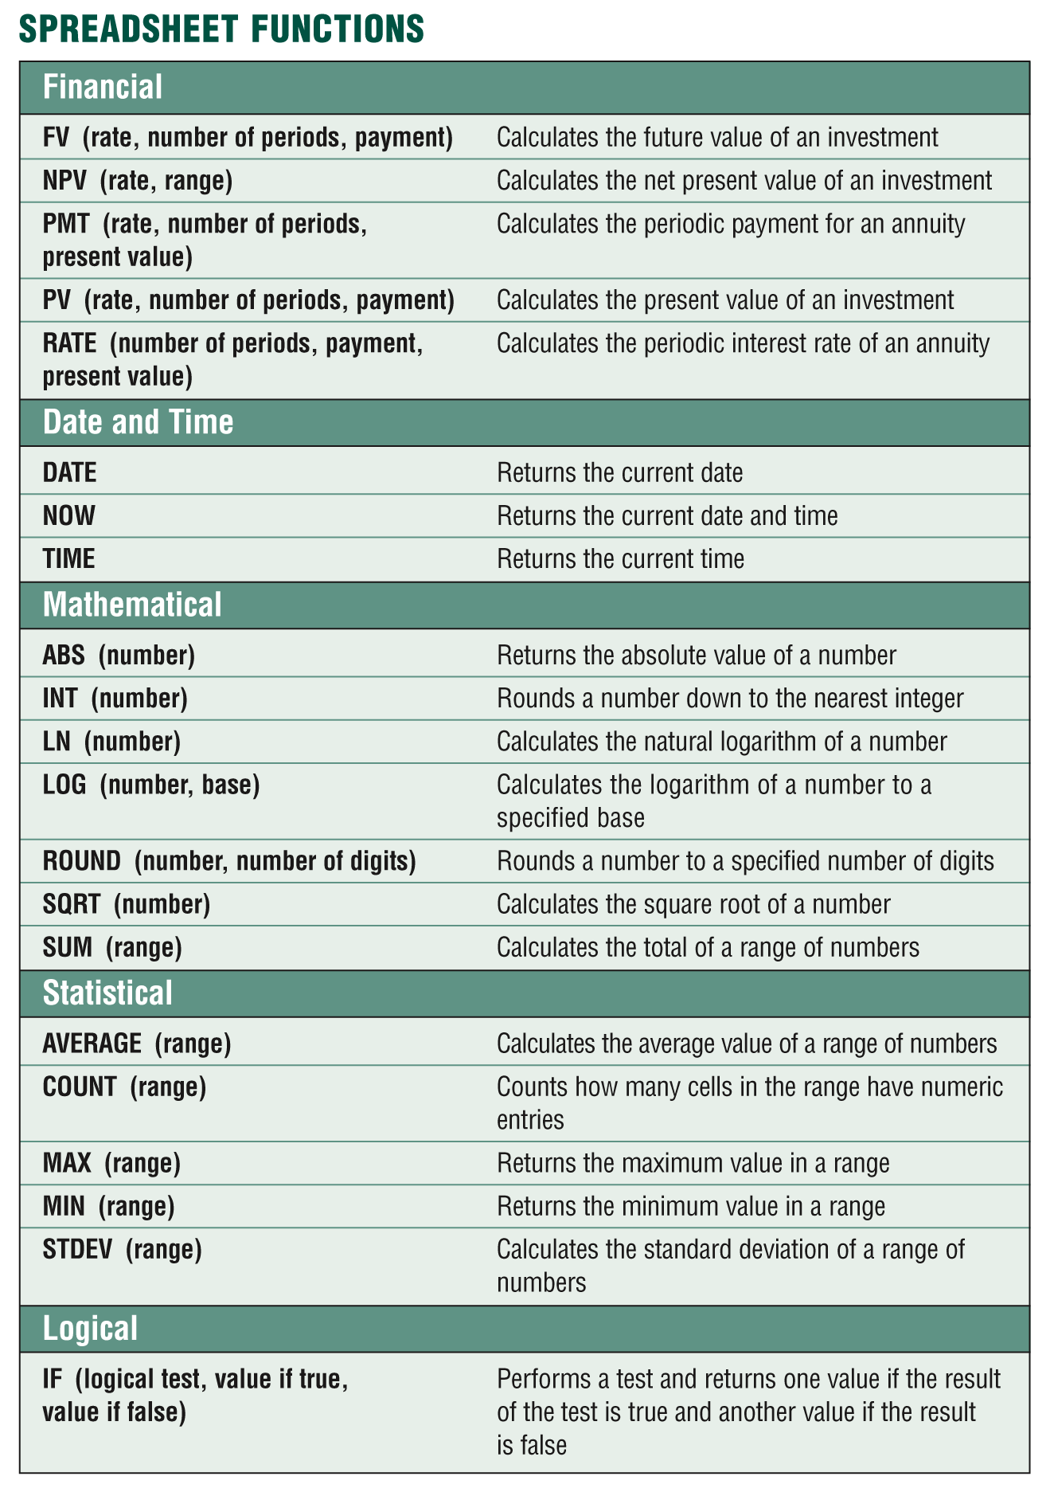
Business Software
What is a function?
  A predefined formula
  that performs
  common calculations
    =B10+B11+B12+B13+B14
    =SUM(B10:B14)
p. 143 Fig. 3-9
Next

Slide 16
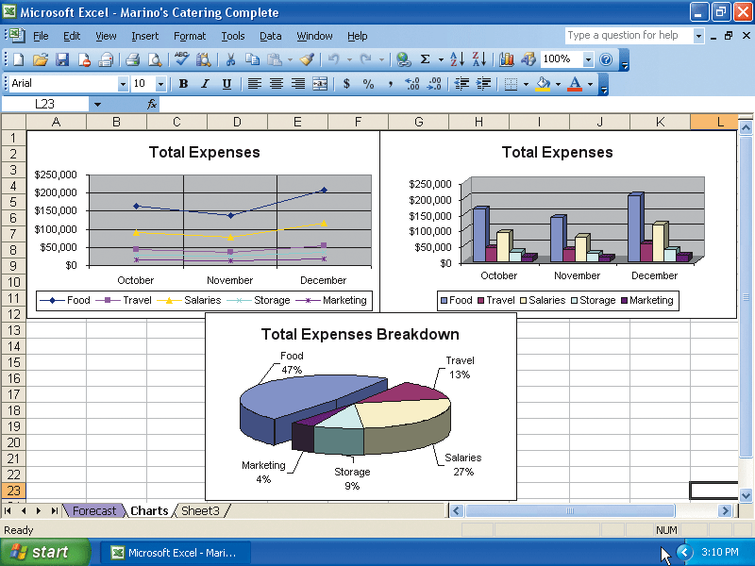
Business Software
What is charting?
  Allows you to display spreadsheet data in graphical form
p. 144 Fig. 3-10
Next

Slide 17
Business Software
What is database software?
Allows you to create
and manage data
Add, change, delete,
sort, and retrieve data
p. 145
Next

Slide 18
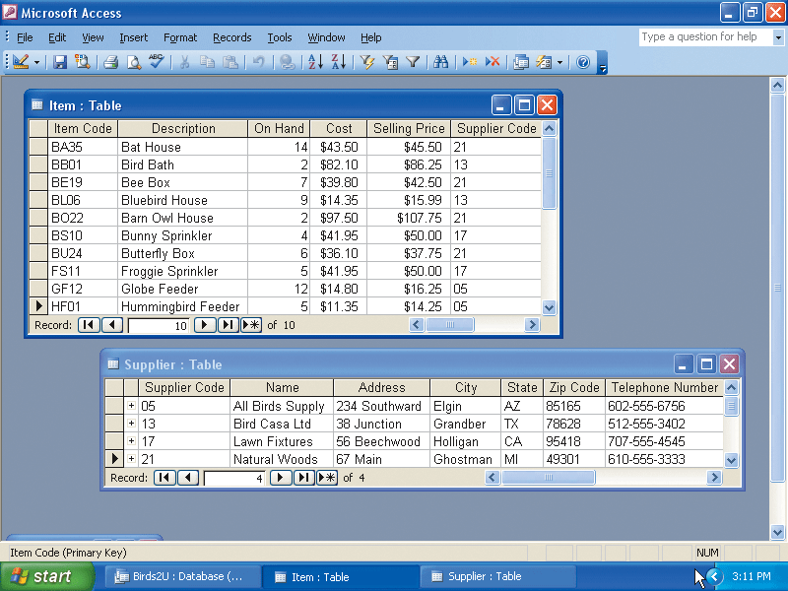
Business Software
What are the parts of a database?
  A table contains records
  A record is a row in a
  table that contains
  information about a
  given person, product,
  object, or event
  A field is a column in
  a table that contains
  a specific category of
  data within a record
p. 145 Fig. 3-11
Next

Slide 19
Business Software
How do you extract information from a database?
Run queries to retrieve data
Can be sent as a report to the printer
p. 145
Next

Slide 20
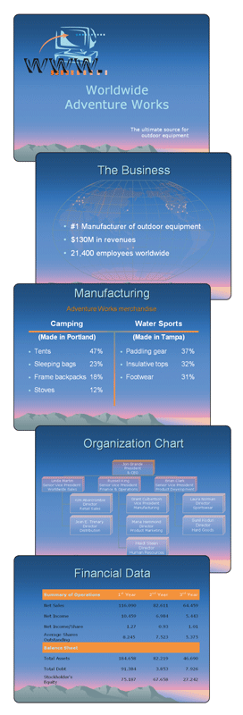
Business Software
What is presentation graphics software?
  Used to create visual aids for presentations
  A presentation is sometimes
  called a slide show
p. 146 Fig. 3-12
Next

Slide 21
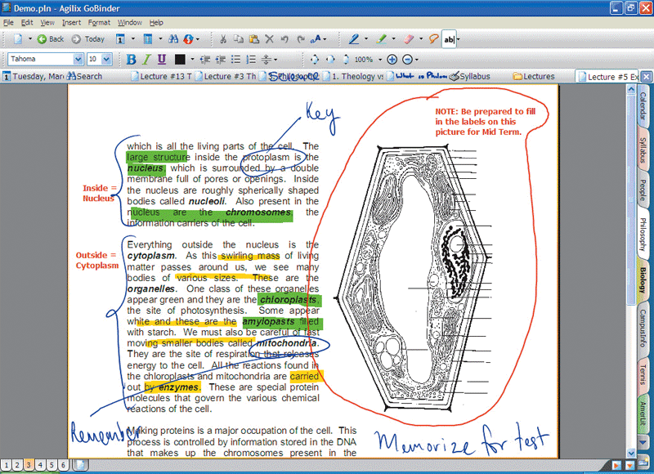
Business Software
What is note taking software?
  Enables users to enter typed text, handwritten comments, drawings, or sketches anywhere on the page
  Notes are organized like a notebook
p. 147 Fig. 3-14
Next

Slide 22
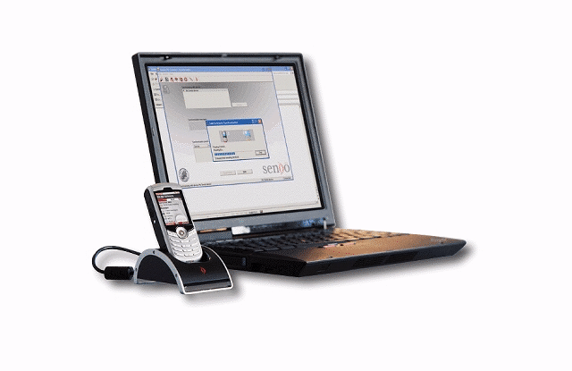
Business Software
What is Personal Information Manager Software?
  Includes a calendar, address book, notepad, and synchronization with
  desktop computer
  Most PDAs and many smart phones include PIM functionality
p. 148 Fig. 3-15
Next

Slide 23
Business Software
What can you do with PDA business software?
Create documents
and worksheets
Manage databases
and lists
Create slide shows
Take notes
Manage budgets
and finances
View and edit
photographs
Read electronic
books
Plan travel routes
Compose and read
e-mail messages
Send instant
messages
Browse the Web
p. 148
Next

Slide 24
Business Software
What is a software suite?
A collection of individual
programs sold as
a single package
Two major advantages:
lower cost
ease of use
p. 148
Next

